Slide 1
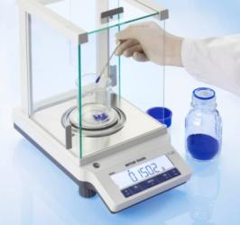
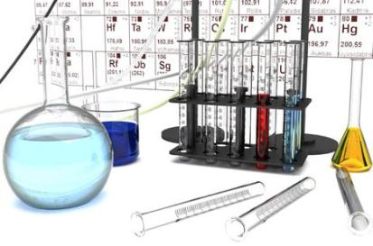
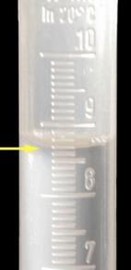
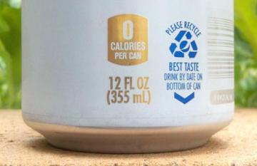
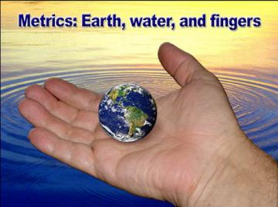
Lab 2: Measurement Tools & Skills
Goals for this Lab
Identify tools used for measurement and their best use: In this lab you will become familiar with many measurement tools, and not just ones used in chemistry. These tools along with your measuring skills will let you discover and communicate accurate and useful facts about items.
Read and record measurements correctly: This objective means you learn how to get the most accuracy out of a measurement tool. You also have to remember to always include the unit of measurement (its dimension, such as inch, gram, etc). In math classes, you normally deal with abstract numbers like 5, 3, and 7.5; however, chemistry deals with measurements, so 5, 3, and 7.5 are not good enough. You have to include the units of measurement such as centimeters (cm), grams (g), or milliliters (mL). Writing 7.5 instead of 7.5 cm is wrong because "cm" is just as important as 7.5.
Associate metric units with quantities being used: Don’t think in just English units, force yourself to think in metric units. The metric system is one of the greatest inventions of mankind. Without a system that allows agreement on measurements such as distance, mass, and volume, the advances in technology would have been impossible. King Louis XVI of France ordered this new system in 1790. Seeing the beauty in its simplicity and ease of standardizing measurements, he declared "Metrics is for all people for all time." Metrics is based on the Earth, water, and the fact we have 10 fingers. Even George Washington and Thomas Jefferson begged the Congress to adopt a system just like the metric system. Congress procrastinated, and we were stuck with the English system.
Applications for measurement: Nearly every discipline involves making measurements. In chemistry, as in many fields, you will frequently be measuring something and be using a variety of measuring tools. These tools could be a simple metric ruler or a complicated pH meter. Because this lab is Chemistry and Society, we are including other instruments not normally seen in chemistry classes because some of the issues facing our society needs measurements that go beyond those used in normal chemistry labs.

Slide 2
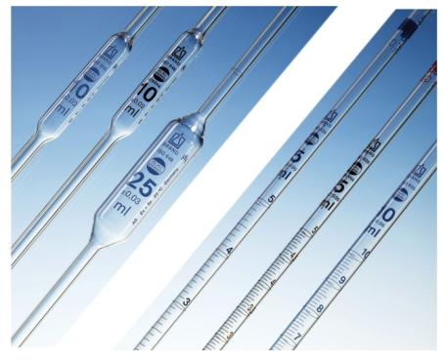
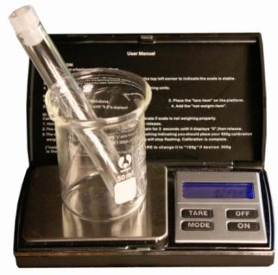
Lab 2: Measurement Tools & Skills
Flask
Graduated Cylinders
Infrared
Erlenmeyer
Alcohol Thermometer in Celsius
Beaker
Thermometer
DIGITAL CALIPERS
VOLUMETRIC FLASKS
Graduated & Volumetric pipettes
Laser Measure
Analytical Balance
Portable Balance
Measuring Syringe
Metric/English Ruler
Micropipette

Slide 3
Lab 2: Measurement Tools & Skills: Distance
Ruler & Tape Measure: Measuring distances such as length, width, and height is probably the most common measurement. The usual tool for that is the ruler or the tape measure. In the United States we often measure in inches, but the rest of the world uses metric, which means we have to learn both. Also, in the United States, the areas of science, engineering, and medicine is mostly metrics.
English based on halves; Metric based on tenths: English rulers and tape measures divide the inch into halves, which are divided into halves to make quarters. That continues until we have eighths, and sixteenths. Metric rulers break the centimeter into tenths, which is the millimeter. 5 millimeters (0.5 centimeter) is usually a longer line.
Actual size ruler: The below ruler shows the actual size of both centimeters and inches. Note one inch is about 2.5 centimeters (2.54 centimeters to be exact). On the next page you will be asked to identify the distance pointed out on the ruler and also draw arrows to certain distances on the ruler.
Digital Calipers: Measuring distances are made easier and more accurate using digital calipers. The below image is actual size. These are usually designed to measure in inches and in millimeters.
On the end of the caliper is a rod that acts as a depth gauge (not shown).
The internal jaws are used to measure inside of items such as tubing or holes.
This button switches between millimeters and inches.
This is a thumb grip that you use to slide the caliper open and close. Some calipers also use a wheel for the same purpose.
The external jaws are for measuring the outside of items to measure width or diameter.
This button is pressed when the caliper is closed to set the distance to zero.

Slide 4
Lab 2: Measurement Tools & Skills: Distance Cont’d
English/Metric Ruler: Different distances are marked on the below ruler. Write down what those distances are. If it sits between lines on the Inches ruler, report it in 32nds of an inch. If on the Centimeters ruler, report it as an increment of 0.05 centimeters.
Wood Block Dimensions: You will be given a block of wood to measure. It will be identified with a number. You will use both a ruler and the digital calipers to measure that block. You will measure it in both inches and centimeters. Remember the calipers reports it as millimeters. So divide by 10 to make it centimeters. Be sure to write inches or cm after the distance.
Block Number: _______
For measuring inches with ruler, show answer to the closest sixteenth of an inch but reduce to simplest fraction. For example, if you count 4 sixteenths, reduce 4/16 to 1/4 inch. Use “in.” as abbreviation for inches or use a quotation mark (”).
For measuring inches with the digital calipers, report it in hundredths of an inch. Use cm as abbreviation for centimeter or centimeters. For reporting centimeters using the ruler, report to the nearest tenth of a centimeter. For reporting centimeters using the calipers, report to it in hundredths of a centimeter.
Using Ruler
Length in inches: _________________
Width in inches: _________________
Height in inches: _________________
Using Ruler
Length in centimeters: _______________
Width in centimeters: _______________
Height in centimeters: _______________
Using Calipers
Length in inches: _________________
Width in inches: _________________
Height in inches: _________________
Using Calipers
Length in centimeters: _______________
Width in centimeters: _______________
Height in centimeters: _______________

Slide 5
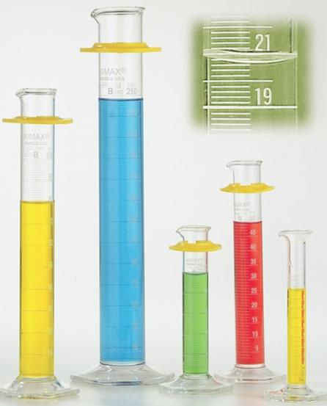
Lab 2: Measurement Tools & Skills: Volume
Graduated Cylinders: In the kitchen, people use measuring cups and spoons to measure volume; however, in chemistry, they use graduated cylinders. Graduated cylinders come in various sizes ranging from 10 mL (2/3 tablespoon) to 4 liters (about 1 gallon).
Accuracy: Just like in the kitchen, you wouldn’t use a quart-size measuring cup to measure one tablespoon nor use 64 tablespoons full to measure out a quart. You use the size that best matches what you are measuring. Also note that water has a tendency to creep up the inside wall of the graduated cylinder. So the water surface isn't flat. It will be bowed. They call this curved surface the meniscus from the Greek word meniskos meaning "crescent" like the crescent of the moon. The bottom of the curve is where you read the water's volume.
Kitchen volumes to milliliters: A teaspoon is 4.93 mL. Use a 10 mL graduated cylinder to measure out 4.93 mL of water. Pour it into a teaspoon.
Fill up a tablespoon and use the 25 mL graduated cylinder to see how many milliliters a tablespoon is.
Fill up one standard cup and use a 100 mL graduated cylinder to find out how many milliliters make one cup.
What happened? Did the water not fill the teaspoon, just fill it, or overflow?
How many mL? ___________________
How many mL? ___________________
What is the volume between two lines? (count spaces) ________________
Line up first rib to the desired volume.
Graduated Syringe vs. Graduated Cylinder: Draw in 7.2 mL of distilled water. Place it in a 10 mL graduated cylinder. What volume does it show?
Give two advantages of graduated syringe:
Give two advantages of graduated cylinder:
____________

Slide 6
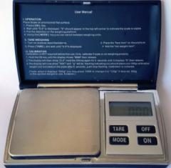
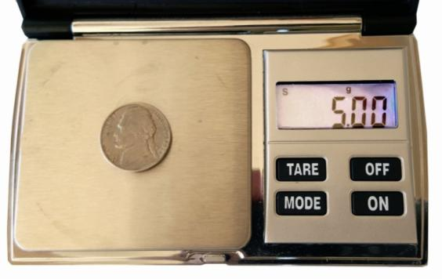
Lab 2: Measurement Tools & Skills: Mass
Portable Digital Scales (balances): These scales (also called pocket scales) are very convenient. They can be taken anywhere and run off batteries. Their accuracy
varies from 0.1 g to 0.001 g. Their maximum
weighing load varies from 20 g to 1000 g
(2.2 lbs).
Analytical Balances: These are found in laboratories. Their
accuracy is usually 0.001 g to 0.0001 g. So they are more accurate than a portable balance but can easily cost $2,000 or more. They also have a limit on how much they can weigh which is about 300 grams. Because they are more accurate, air currents can cause
the readout to fluctuate, which is why analytical balances always
have glass walls to stop any air currents from hitting the weighing pan.
Portable Digital Scale buttons and screen: Analytical balances usually only measure in grams, but portable scales often measure in six units of mass. To pick which unit, you use the MODE button, but first turn on the scale and wait until you see the letter “S” in the upper left corner. That means it is Stable.
Set mode: Press the mode button repeatedly and look at the abbreviations at the top of the screen. You will see the below abbreviations:
g = grams (metric unit of mass)
ozt=troy ounces (for precious metals)
dwt=drams (old unit for medicine=1/16 oz)
ct=carat (used for weighing jewels)
oz=ounces (used in USA, 16 oz=1 lb.)
GN=grains (used to weigh gun powder)
Weigh nickel on portable scale: Set mode to grams (g). A nickel has an easy mass to remember. A nickel is 5 cents and it weighs 5 grams. Use it to see if your scale weighs the nickel between 4.98 g and 5.02 g. If not, contact your instructor to calibrate the scale.
Using TARE : The word “tare” is from Arabic “tarah” meaning “to throw away”. So pressing the tare button tells the scale to “throw away” any mass on the scale so the scale reads “0.00”. So that’s the first button you push after turning it on and after it has stabilized.
Shortcut: One clever use of using tare is to zero out the mass of a container. For example, in the photo on the right, the mass of the beaker and the test tube can be tared and the balance will read “0.00”. As you remove the test tube, the balance will show a negative number equal to the mass of the test tube. If you replace the test tube with a matching test tube that has something in it, the balance will show the mass of the contents of the second test tube.

Slide 7
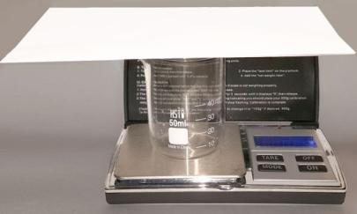
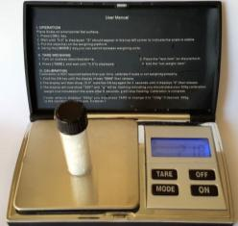
Lab 2: Measurement Tools & Skills: Mass continued
Stamps for Envelope: One stamp is good for a letter up to one ounce. If it goes over, you will need an extra stamp. So the first thing to do is set your scale to read “oz” (for ounces). If you tried to lay an envelope directly on the scale, it would block the readout screen. So you first need something to elevate it. The 50 mL beaker in your lab drawer works well.
After placing the 50 mL beaker on your scale, press TARE so the screen shows 0.00 oz. Now the balance will only weigh the envelope. Place the envelope on top of the beaker.
1a) What is the envelope number? ________ 1b) What is the mass in ounces? _________
The Art of Counting without Counting: Some chemistry problems require you to keep track of atoms, but atoms are too small to count and too many to count. So chemistry uses methods that allow you to count atoms by weighing them. The same method can be used to count anything that may be too small to count or too many to count. In this example, we want to create a poster that uses glitter (small flakes of plastic) to represent stars.
Stars in the Sky: The number of stars that you can see in a moonless sky far from city lights is about 4,000 stars. Let’s say you have a small vial of glitter and you want to know if there are at least 4,000 pieces of glitter to represent the stars in the sky..
Shortcut for weighing: A shortcut is to place a matching vial that is empty on the scale and TARE it. Take it off and place the vial with the glitter on it. The scale will show just the mass of the glitter. 2) What is the mass of the glitter in your vial? _________ grams
To see how many pieces of glitter that is, you need to know the mass of one piece or the mass of a certain number of pieces. Previously 100 of these glitter pieces were weighed and found to be 0.028 grams. So that can be stated either as 0.028 grams per 100 pieces or 100 pieces per 0.028 grams.
These mass to number relationships can be written as fractions.
Calculate number of pieces in vial: To calculate the number of pieces based on the mass of the glitter, we will use the fraction that has 100 pieces on top since want to know the number of pieces. If you multiply that fraction by the grams of glitter in the vial “2)”, the grams cancel and the answer will be in pieces of glitter.
3a) How many pieces of
glitter are in the vial? ___________
Calculate mass (in grams) that will be 4,000 pieces : To calculate the mass that will have 4,000 pieces, we use the left fraction which has 0.028 grams on top. That ensures our answer will be grams. We then multiply by the 4,000 pieces. Pieces will cancel and leave us just with grams.
3b) How many grams of
glitter give you 4,000 pieces? ________ g

Slide 8
Lab 2: Measurement Tools & Skills: Temperature
Mercury vs. Alcohol thermometers: In the past, mercury thermometers were
the most popular, but after realizing the hazards of mercury from a broken
thermometer, the industry switched to thermometers filled with dyed
alcohol. Alcohol thermometers do not have the same range of
temperatures as a mercury thermometer, but they are
cheaper and safer.
Digital Thermometers: Recently, thermometers are using various electronic sensors to detect temperature. For people, they have digital thermometers used specifically to measure the body temperature based on oral, rectal, forehead, or ear temperatures. For industrial or scientific applications, a digital thermometer with a probe is often used. We
also have the Infrared thermometers that
don’t even need to touch the item.
Alcohol Thermometer: Use your alcohol thermometer to measure the temperature of the air in the room and water from the faucet. Write °C after temperature.
Room temperature? ________________
Water temperature? ________________
Infrared Thermometer: Use the lab’s infrared thermometer
to measure the temperature of a hot plate, ceiling tile, floor,
Air conditioning vent, and skin. Report in °C and °F.
Hot Plate: ______________ Ceiling: _____________ Floor: ____________
Air conditioning vent: _____________ Skin: ________________
Other: If the lab has another specialized thermometer on hand, use it to measure something of your choice. What is the device? What did you measure? And what is its temperature?

Slide 9
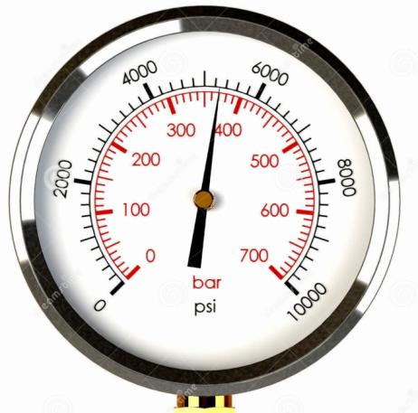
Lab 2: Measurement Tools & Skills: Analog Gauges
Analog vs. Digital gauges: Digital readouts are easy. The fractions of the measurement is shown on the screen as a decimal fraction. For example, a digital thermometer that shows 36.8 °C grams makes it easy to see the fraction is 0.8°C. However, with an analog thermometer, like the one below, it’s not so easy. The whole degrees of 35, 36, 37, etc. are easy to see, but to determine the fraction of a degree, you need to count the spaces between the full degrees. I count 10 spaces, so that means each degree is divided up into tenths of a degree. So the temperature here is 39.3 °Celsius.
Analog Oil Temperature Gauge: Notice the labeled marks are every 10 degrees. The small marks break the labeled marks into 5 steps (count the spaces). How many degrees
are between each mark? ________
What is the temperature? ____________
If water contacted this oil, would the water boil? ______
Analog Air Pressure Gauge: The outer scale is in psi (pounds per square inch). How many psi are between each small mark? ________
The needle is indicating what psi? ____________
The inner scale is measured in bars. How many bars of
pressure is each step (small mark)? ____________
The needle is indicated how many bars? ___________
Other gauges: The lab will have other analog gauges.
For each of them, give gauge name and its reading.

Slide 10
Lab 2: Measurement Tools & Skills: Extra Credit
If you have time, you may want to do these extra credit activities.
Laser Measure: Use the laser measure device to find the length, width, and height of the lab in feet with inches.
Length: ______ Width: ________ Height: _________
Graduated Pipette: Measure 4.2 mL in a 5 mL graduated pipette. Place the water into a 10 mL graduated cylinder.
What volume does it show? ___________________
Volumetric Flask: Fill a volumetric flask to its set volume. Place the water into a beaker that has a mark for that volume. Do they match?
__________________________________________________
Lab 2: Measurement Tools & Skills: Clean Up
Any labware that came in contact with any liquid besides distilled water needs to be rinsed with distilled water then dried with paper towel.
To do measuring activities at home, you will need to check out some of the equipment that you used in this lab. Instructor will give you the list of items you should take home by end of the lab.

